Slide 1
Cassandra CQL Introduction
Penny Weng 翁瑞昕

Slide 2
Table of Contents
Definitions
Create / Alter / Drop Keyspace
Create / Alter / Drop / Truncate Table
Select / Insert / Update / Delete / Batch Functions
Data Types
Counters
Timestamps
Duration
Maps, Sets, Lists
UDT (User-Defined Types)

Slide 3
Definitions: Identifiers and keywords
Identifiers and (unquoted) keywords are case insensitive. Thus SELECT is the same than select or sElEcT, and myId is the same than myid or MYID.
quoted identifier defined by enclosing an arbitrary sequence of characters (non-empty) in double-quotes("). Quoted identifiers are never keywords.
CQL supports prepared statements. Prepared statements are an optimization that allows to parse a query only once but execute it multiple times with different concrete values.
A bind marker can be either anonymous (?) or named (:some_name).

Slide 4
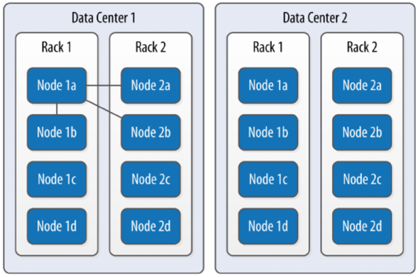
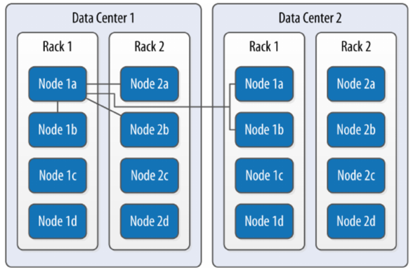
Create / Alter / Drop KEYSPACE
# SimpleStrategy
Create Keyspace: Replication 說明: * SimpleStrategy: 將資料放在同 DC 不同節點中 * NetworkTopologyStrategy: 跨 DC 分散資料, 通常選這個
CREATE KEYSPACE excelsior WITH replication = {'class': 'SimpleStrategy', 'replication_factor' : 3};
CREATE KEYSPACE excalibur WITH replication = {‘class’: ‘NetworkTopologyStrategy’, ‘DC1’ : 3, ‘DC2’ : 3}; => 指定 replication 個數
CREATE KEYSPACE excalibur WITH replication = {‘class’: ‘NetworkTopologyStrategy’, ‘replication_factor’ : 3}; => 不指定 replication 個數, auto-expanding datacenters, 如果只有兩個 datacenter, 效果會跟上面的 CQL 一樣
CREATE KEYSPACE IF NOT EXISTS excelsior WITH replication = {'class': 'SimpleStrategy', 'replication_factor' : 3};
# NetworkTopologyStrategy

Slide 5
Create / Alter / Drop KEYSPACE
Show Create CQL: DESCRIBE KEYSPACE excelsior;
Before Create Table: USE excelsior;
Revise Keyspace: ALTER KEYSPACE excelsior WITH replication = {'class': 'SimpleStrategy', 'replication_factor' : 4};
Drop Keyspace: DROP KEYSPACE IF EXISTS excelsior;

Slide 6
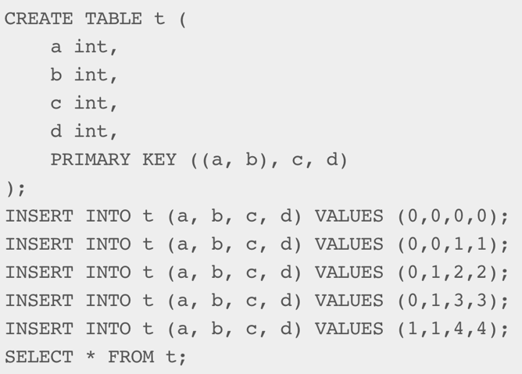
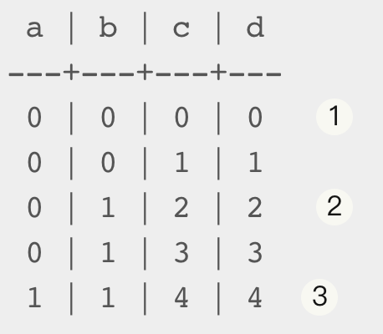
Create / Alter / Drop TABLE
Partition Key
It is the first component of the primary key definition.
A partition is the set of rows that share the same value for their partition key.
A hash is computed from the partition key columns and that hash value defines the partition location.
All the rows belonging to the same partition are guaranteed to be stored on the same set of replica nodes.
Partition 1
Partition 2
Partition 3

Slide 7
Create / Alter / Drop TABLE
Clustering Columns
The columns that follow the partition key in the primary key definition.
Define the clustering order for the partition of that table. That sorting allows the very efficient retrieval of a range of rows within a partition.
Primary Key
PRIMARY KEY (a): a is the single partition key and there are no clustering columns
PRIMARY KEY (a, b, c): a is the single partition key and b and c are the clustering columns
PRIMARY KEY ((a, b), c): a and b compose the composite partition key and c is the clustering column

Slide 8
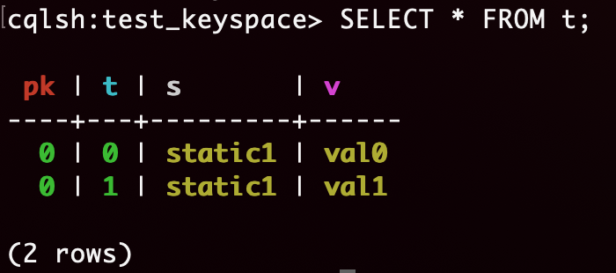
Create / Alter / Drop TABLE
Create Table: CREATE TABLE IF NOT EXISTS t ( pk int, t int, v text, s text static, PRIMARY KEY (pk, t) ); INSERT INTO t (pk, t, v, s) VALUES (0, 0, 'val0', 'static0'); INSERT INTO t (pk, t, v, s) VALUES (0, 1, 'val1', 'static1'); SELECT * FROM t;
Result:
A column that is static will be “shared” by all the rows belonging to the same partition.
Notes:
Explanation source: bmc.com/blogs/cassandra-clustering-columns-partition-composite-key/
each table requires a unique primary key. The first field listed is the partition key, since its hashed value is used to determine the node to store the data. If those fields are wrapped in parentheses then the partition key is composite. Otherwise the first field is the partition key. Any fields listed after the partition key are called clustering columns. These store data in ascending or descending order within the partition for the fast retrieval of similar values. All the fields together are the primary key.

Slide 9
Create / Alter / Drop TABLE
Add/Drop Table’s Columns: ALTER TABLE t ADD {column} {column_type}; ALTER TABLE t DROP {column};
Drop Table: immediate, irreversible removal of the table and data. DROP TABLE IF EXISTS t;
Truncate Table: permanently removes all existing data from the table, but without removing the table itself. TRUNCATE TABLE t;

Slide 10
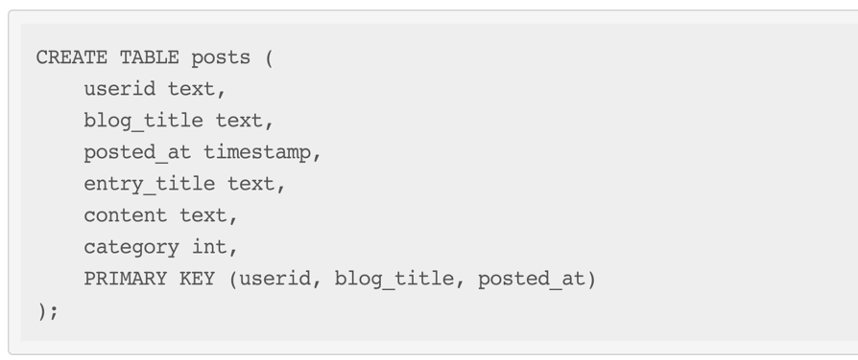
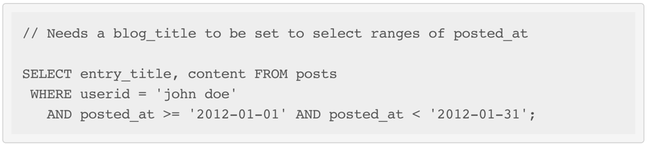
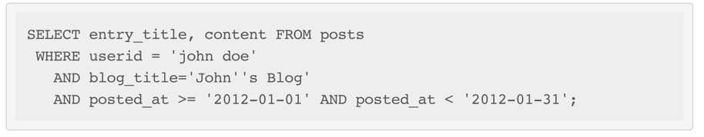
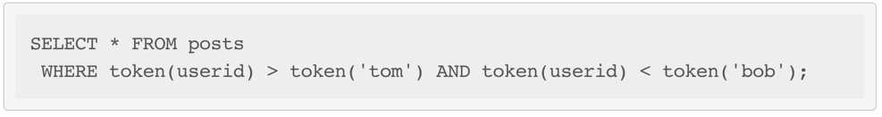
Select / Insert / Update / Delete / Batch Functions
Select
No joins or sub-queries. A select statement only apply to a single table.
Can use WRITETIME and TTL. Ex 1. SELECT WRITETIME(v) FROM t; Ex 2. SELECT TTL(v) FROM t;
The relationship for clustering columns must specify a contiguous set of rows to order.
* But the following does not select a contiguous set of rows:
* The TOKEN function can be applied to the PARTITION KEY column to query. Rows will be selected based on the token of the PARTITION_KEY rather than on the value:
* The following query is allowed:
Notes:
拿同一個 node 的資料, 可以直接算 Hash => token().
TTL: specifies an optional Time To Live (in seconds) for the inserted values. If set, the inserted values are automatically removed from the database after the specified time. Note that the TTL concerns the inserted values, not the columns themselves. This means that any subsequent update of the column will also reset the TTL (to whatever TTL is specified in that update). By default, values never expire.

Slide 11
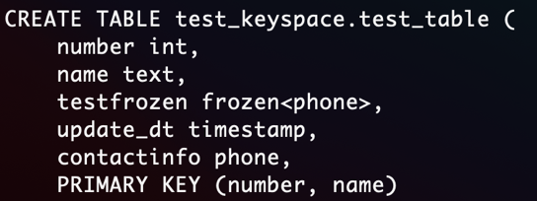
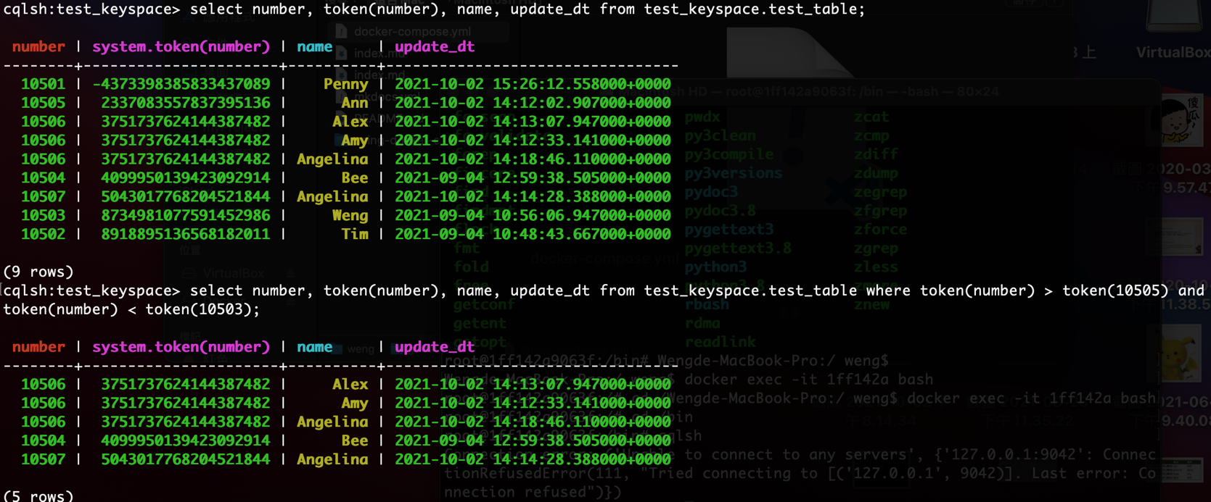
Select / Insert / Update / Delete / Batch Functions
Select
range search (partition key)

Slide 12
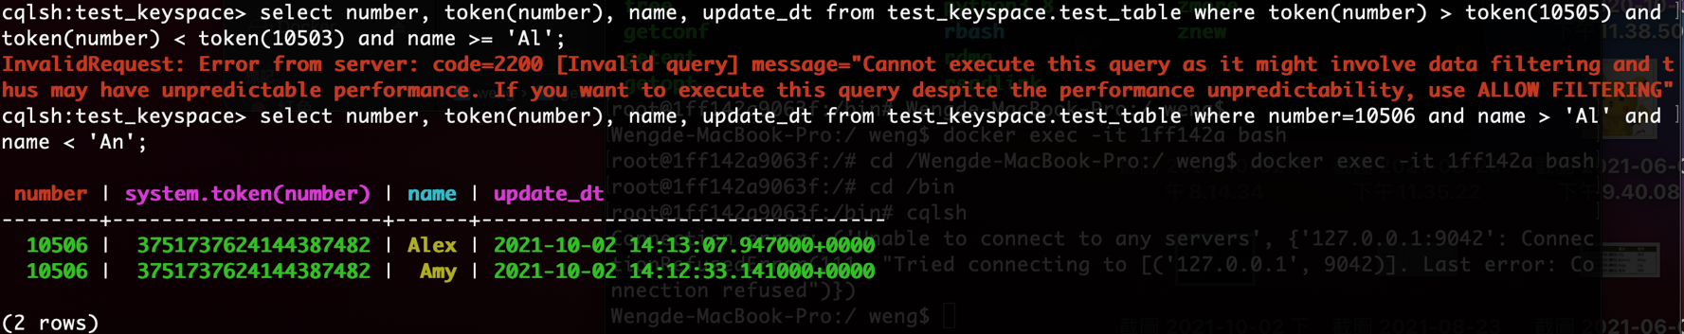
Select / Insert / Update / Delete / Batch Functions
Select
range search (clustering key)
Notes:
類比一下傳統資料庫，Where 條件送 Partition Key 就好比通過 HASH 索引定位記錄，ALLOW FILTERING 就如同先做一次 TABLE SCAN，讀出大量記錄再從記錄裡過濾出符合 WHERE 條件的。
https://www.gushiciku.cn/pl/pcjn/zh-tw

Slide 13
Select / Insert / Update / Delete / Batch Functions
Select
range search (clustering key)
Where 條件送 Partition Key 就好比通過 HASH 索引定位記錄，ALLOW FILTERING 就如同先做一次 TABLE SCAN，讀出大量記錄再從記錄裡過濾出符合 WHERE 條件的。 (https://www.gushiciku.cn/pl/pcjn/zh-tw)
Notes:
類比一下傳統資料庫，Where 條件送 Partition Key 就好比通過 HASH 索引定位記錄，ALLOW FILTERING 就如同先做一次 TABLE SCAN，讀出大量記錄再從記錄裡過濾出符合 WHERE 條件的。
https://www.gushiciku.cn/pl/pcjn/zh-tw

Slide 14
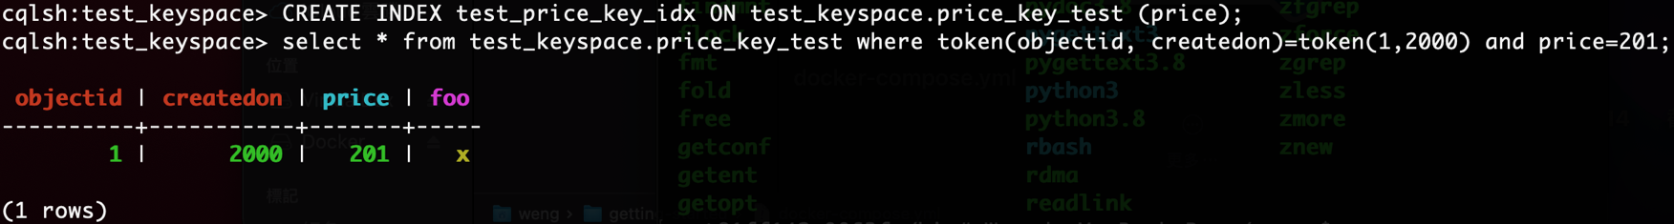
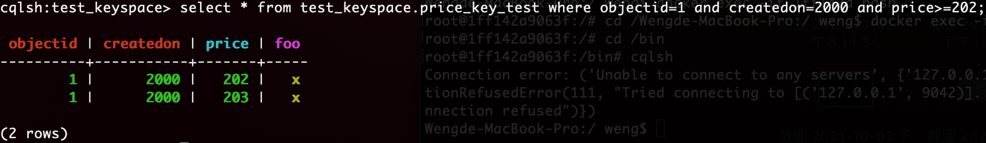
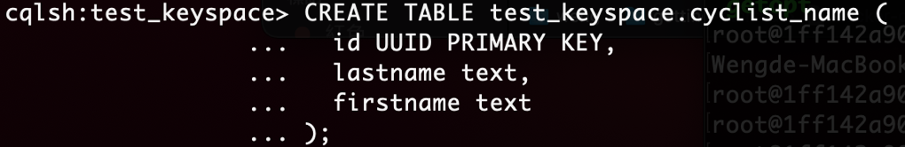
Select / Insert / Update / Delete / Batch Functions
Select
range search (other keys)
建 Index 搜尋
SSTable Attached Secondary Indexes (SASI): improved the performance of secondary indexes
Notes:
CREATE INDEX => 不能 multi index
https://docs.datastax.com/en/dse/5.1/cql/cql/cql_using/useSASIIndex.html

Slide 15
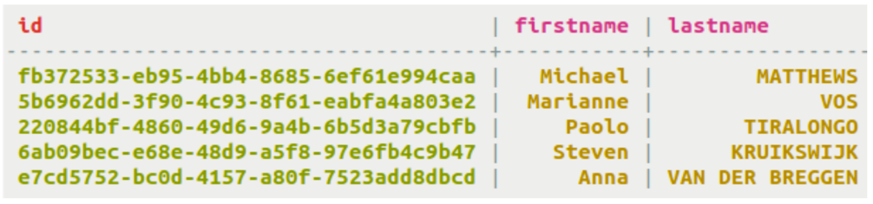
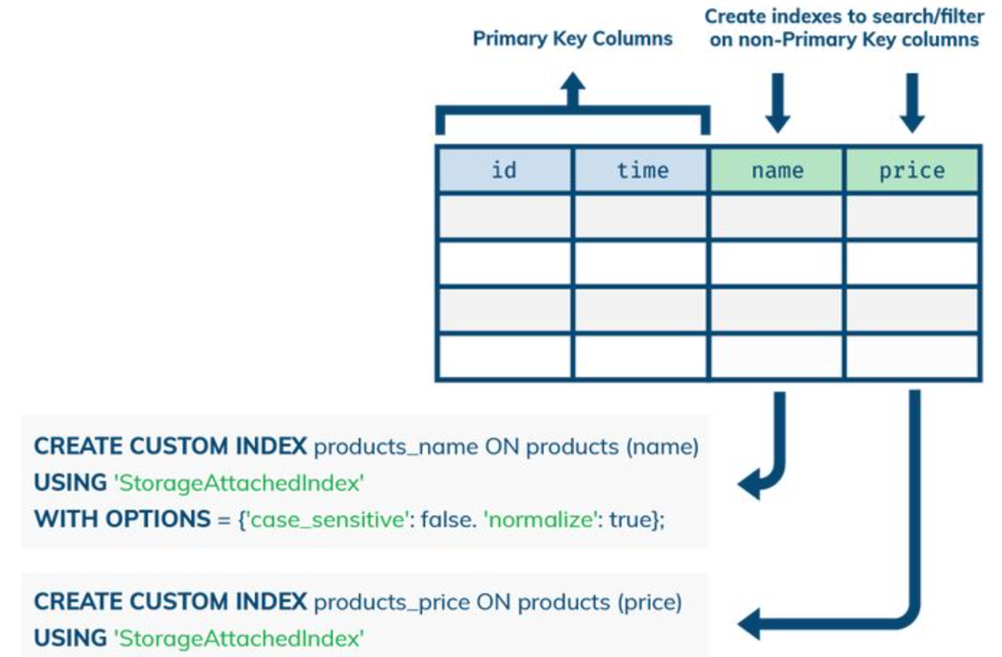
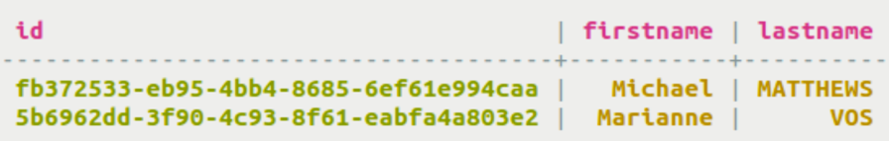
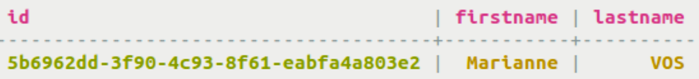
Select / Insert / Update / Delete / Batch Functions
Select
range search (other keys)
SSTable Attached Secondary Indexes (SASI)
PREFIX index (Default Mode)
CREATE CUSTOM INDEX fn_prefix ON cyclist_name (firstname) USING 'org.apache.cassandra.index.sasi.SASIIndex’;
SELECT * FROM cyclist_name WHERE firstname LIKE 'M%’;
CONTAINS index
CREATE CUSTOM INDEX fn_contains ON cyclist_name (firstname) USING 'org.apache.cassandra.index.sasi.SASIIndex’ WITH OPTIONS = { 'mode': 'CONTAINS’ };
SELECT * FROM cyclist_name WHERE firstname LIKE '%M%’;
SELECT * FROM cyclist_name WHERE firstname > 'Mar' ALLOW FILTERING;
Notes:
https://docs.datastax.com/en/dse/5.1/cql/cql/cql_using/useSASIIndex.html

Slide 16
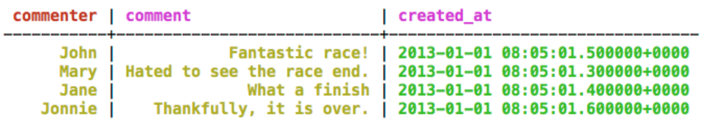
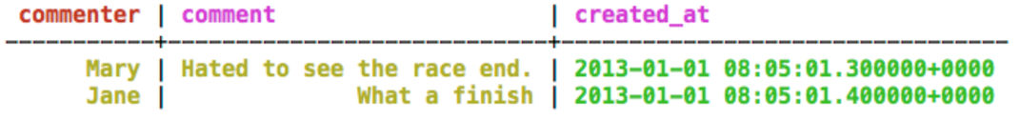
Select / Insert / Update / Delete / Batch Functions
Partition Key
Select
range search (other keys)
SSTable Attached Secondary Indexes (SASI)
SPARSE index
The SPARSE index is meant to improve performance of querying large, dense number ranges like timestamps for data inserted every millisecond. If the data is numeric, millions of columns values with a small number of partition keys characterize the data, and range queries will be performed against the index, then SPARSE is the best choice.
By sparse, it means that for each indexed value, there are very few (maximum 5 actually) matching rows. If there are more than 5 matching rows, an exception similar to the one below will be thrown: java.io.IOException: Term - ‘xxx’ belongs to more than 5 keys in SPARSE mode, which is not allowed. ➔. index 對到的 rows count > 5 會報異常
CREATE CUSTOM INDEX fn_contains ON cyclist_name (age) USING 'org.apache.cassandra.index.sasi.SASIIndex' WITH OPTIONS = { 'mode': 'SPARSE' };
SELECT * FROM cycling.comments WHERE created_at < '2013-01-01 00:05:01.500';
Notes:
https://docs.datastax.com/en/dse/5.1/cql/cql/cql_using/useSASIIndex.html

Slide 17
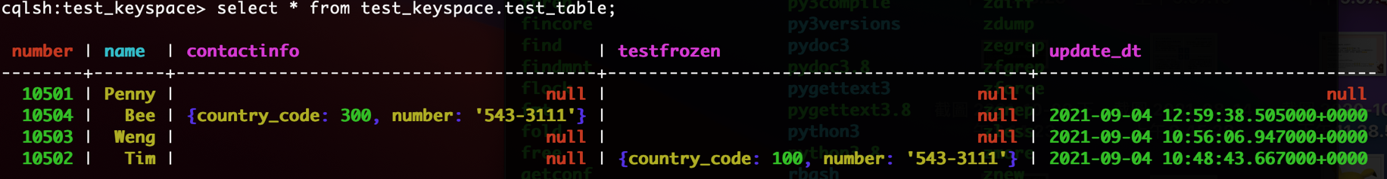
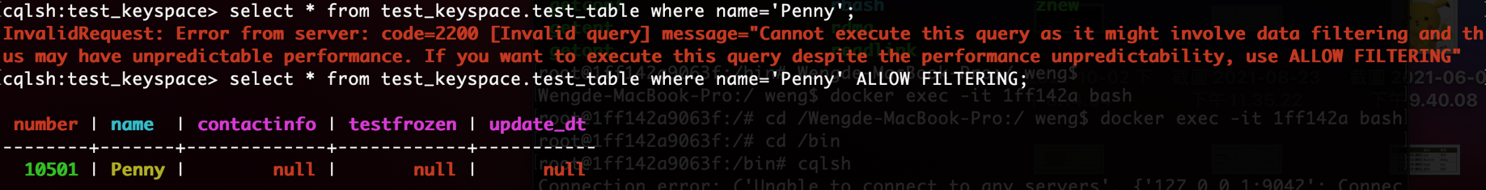

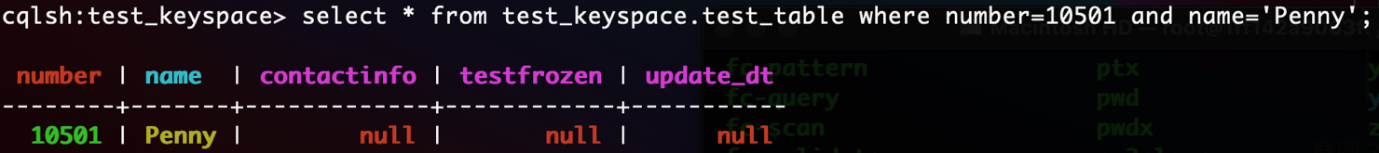
Select / Insert / Update / Delete / Batch Functions
Select
Best performance

Slide 18
Select / Insert / Update / Delete / Batch Functions
Insert / Update
Unlike in SQL, INSERT / UPDATE does not check the prior existence of the row by default. The row is created if none existed before, and updated otherwise. Furthermore, there is no means of knowing which action occurred.
Ex. INSERT INTO NerdMovies (movie, director, main_actor, year) VALUES (‘Serenity’, ‘Joss Whedon’, ‘Nathan Fillion’, 2005) USING TTL 86400;
Ex. UPDATE NerdMovies USING TTL 400 SET director = 'Joss Whedon', main_actor = 'Nathan Fillion', year = 2005 WHERE movie = 'Serenity’;
Support TTL (an optional Time To Live (in seconds) for the inserted values)
Delete
Ex. DELETE FROM NerdMovies USING TIMESTAMP 1240003134 WHERE movie = 'Serenity';

Slide 19
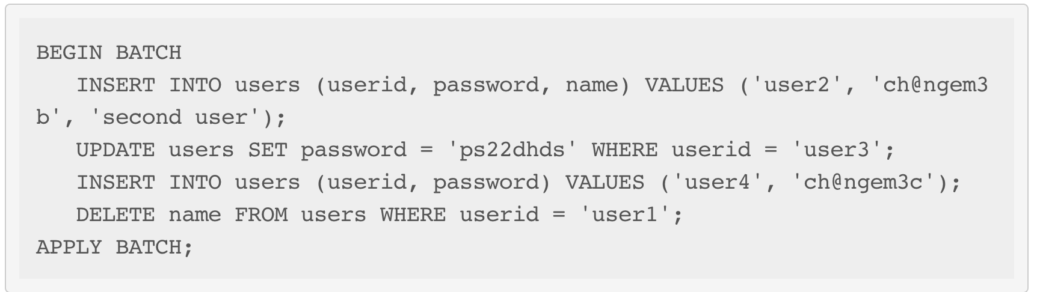
Select / Insert / Update / Delete / Batch Functions
Batch
Multiple INSERT, UPDATE and DELETE can be executed in a single statement.
Saves network round-trips between the client and the server (and sometimes between server coordinator and replicas) when batching multiple updates.
If a timestamp is not specified for each operation, then all operations will be applied with the same timestamp.
UNLOGGED batches (for performance penalty)

Slide 20
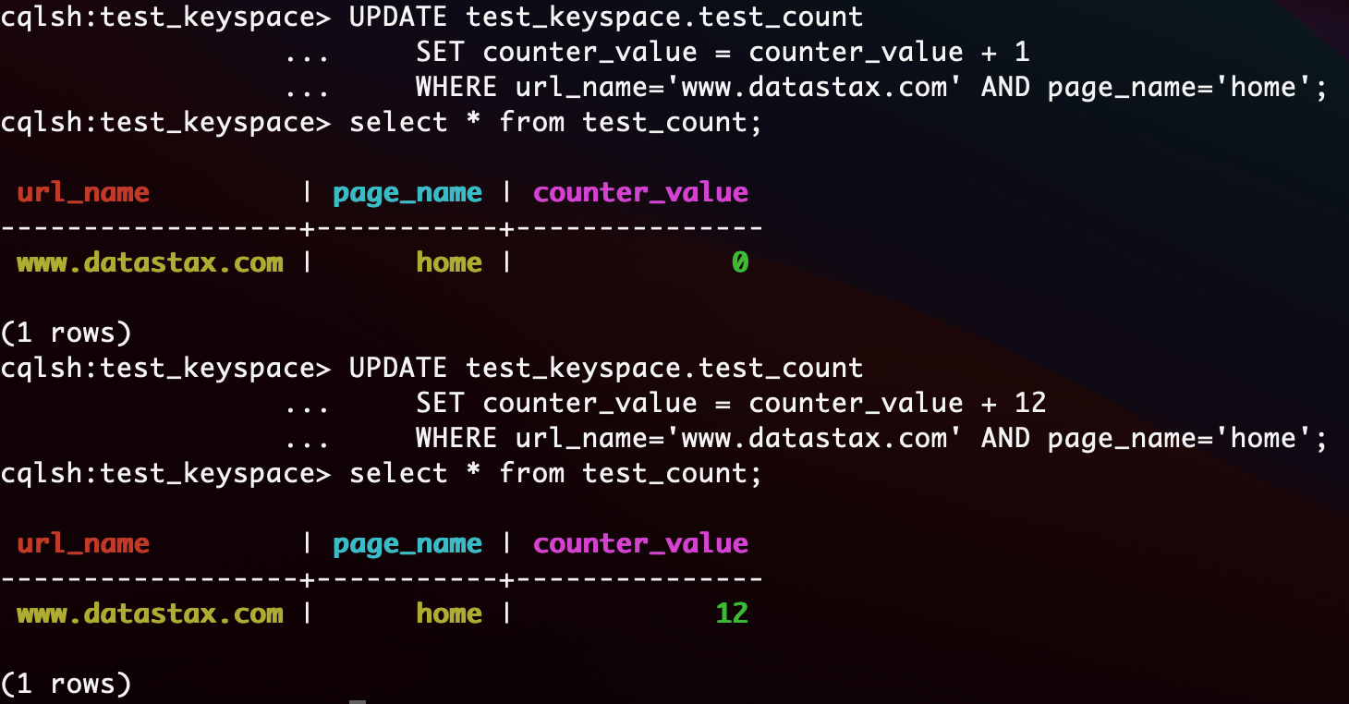
Data Types: Counters
Record the user visited websites’ number
Notes:
CREATE KEYSPACE test_keyspace WITH REPLICATION = { 'class' : 'SimpleStrategy', 'replication_factor' : 1 };
use test_keyspace ;
CREATE TABLE test_keyspace.test_count
(
counter_value counter,
url_name varchar,
page_name varchar,
PRIMARY KEY (url_name, page_name)
);
UPDATE test_keyspace.test_count
SET counter_value = counter_value + 1
WHERE url_name='www.datastax.com' AND page_name='home';
select * from test_count;
UPDATE test_keyspace.test_count
SET counter_value = counter_value + 12
WHERE url_name='www.datastax.com' AND page_name='home';
select * from test_count;

Slide 21
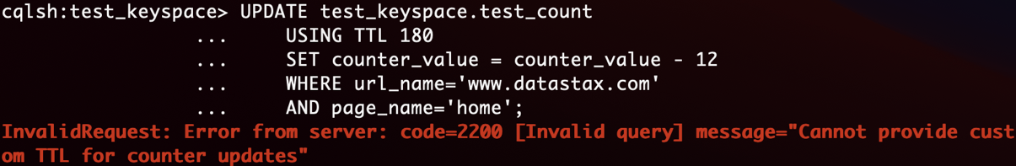
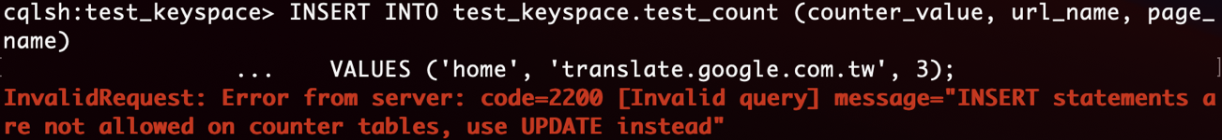
Data Types: Counters Limit
They cannot be used for columns part of the PRIMARY KEY of a table.
A table that contains a counter can only contain counters. In other words, either all the columns of a table outside the PRIMARY KEY have the counter type, or none of them have it.
非 counter 須在主鍵，所以 counter table 只能用來做計數器，基本不能做別的事
不能 set counter_value = 10，可以set counter_value = counter_value + 10
想重置計數器只能讀取計數器的值，然後加上這個值的負數值
如果遇到超時寫入失敗，重新發送請求，可能導致額外計數
Cannot use “USING TTL”
Cannot use “INSERT”

Slide 22
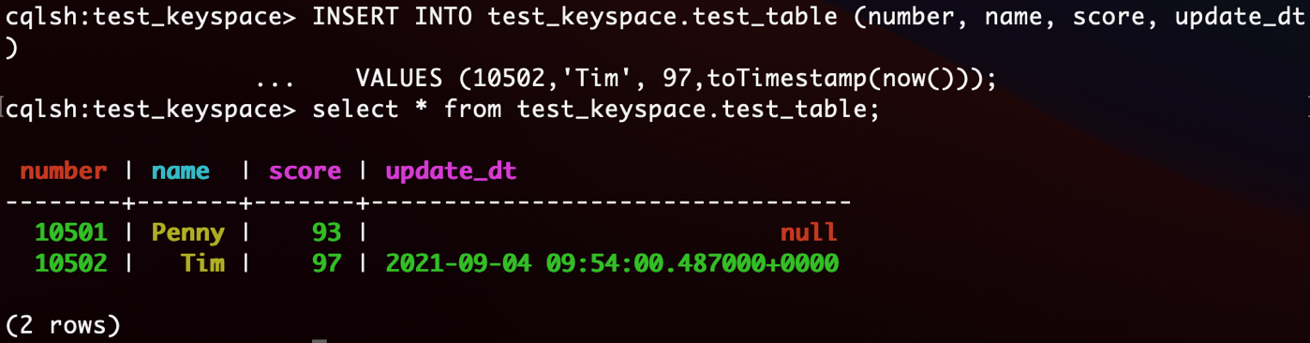
Data Types: Timestamps
Types
Timestamp: can be input in CQL either using their value as an integer, or using a string that represents an ISO 8601 date. Ex. Mar 2, 2011, at 04:05:00 AM, GMT: 1299038700000, or '2011-02-03 04:05+0000’, or '2011-02-03 04:05:00+0000’, or '2011-02-03 04:05:00.000+0000’…
Date: the format should be “yyyy-mm-dd”
CQL language: update with current time
Timestamp: toTimestamp(now())
Date: dateof(now())
Notes:
CREATE TABLE test_keyspace.test_table (
number int,
name text,
score double,
PRIMARY KEY (number, name)
);
INSERT INTO test_keyspace.test_table (number, name, score)
VALUES (10501,'Penny', 93);
ALTER TABLE test_keyspace.test_table
ADD update_dt timestamp;
INSERT INTO test_keyspace.test_table (number, name, score, update_dt)
VALUES (10502,'Tim', 97,toTimestamp(now()));
select * from test_keyspace.test_table;

Slide 23
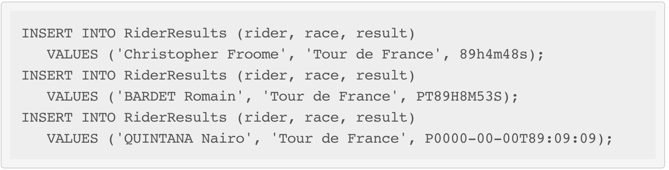
Data Types: Duration
Example
Duration columns cannot be used in a table’s PRIMARY KEY. This limitation is due to the fact that durations cannot be ordered. It is effectively not possible to know if 1mo is greater than 29d without a date context.

Slide 24
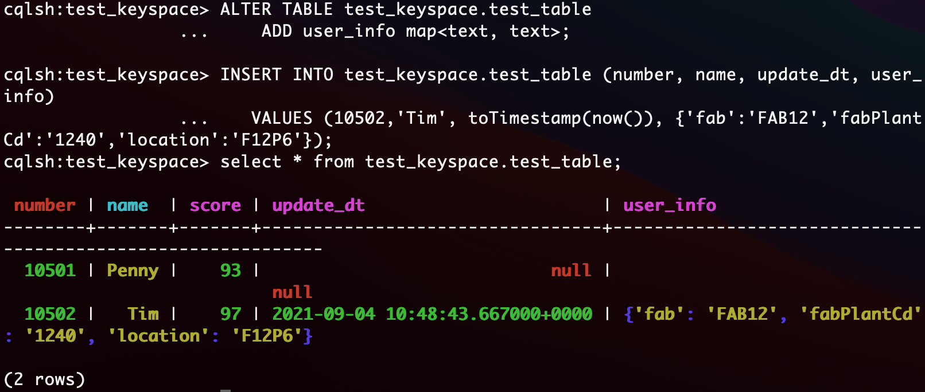
Data Types: Maps, Sets, Lists
Maps
Notes:
ALTER TABLE test_keyspace.test_table
ADD user_info map<text, text>;
INSERT INTO test_keyspace.test_table (number, name, update_dt, user_info)
VALUES (10502,'Tim', toTimestamp(now()), {'fab':'FAB12','fabPlantCd':'1240','location':'F12P6'});
select * from test_keyspace.test_table;

Slide 25
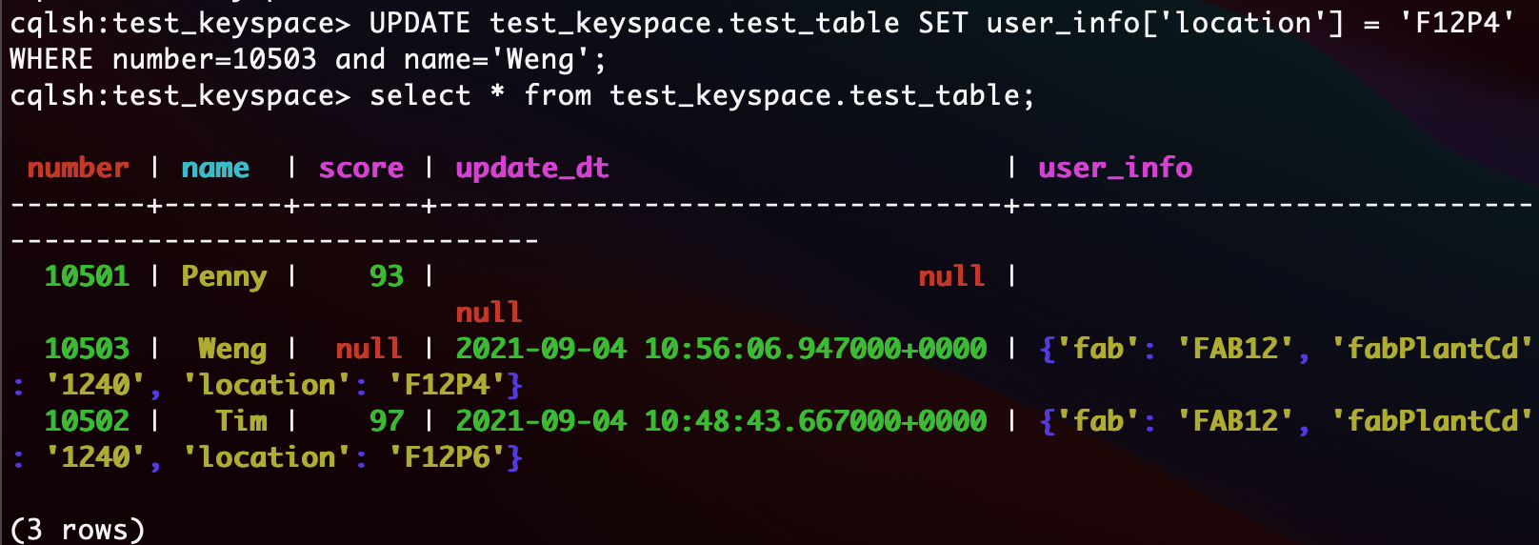
Data Types: Maps, Sets, Lists
Maps: By key update
Notes:
UPDATE test_keyspace.test_table SET user_info['location'] = 'F12P4' WHERE number=10503 and name='Weng';
select * from test_keyspace.test_table;

Slide 26
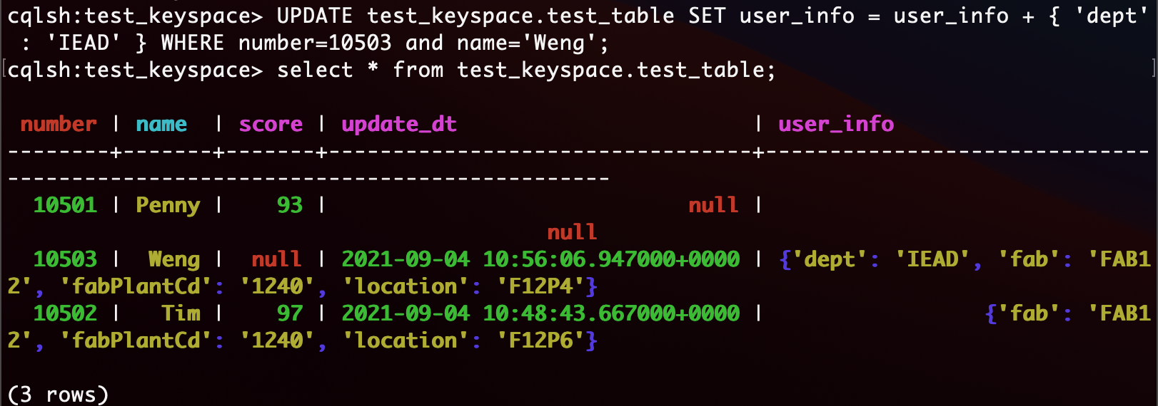
Data Types: Maps, Sets, Lists
Maps: Add or delete key-value pairs by “+” or “-”.
Notes:
UPDATE test_keyspace.test_table SET user_info = user_info + { 'dept' : 'IEAD' } WHERE number=10503 and name='Weng';
select * from test_keyspace.test_table;

Slide 27
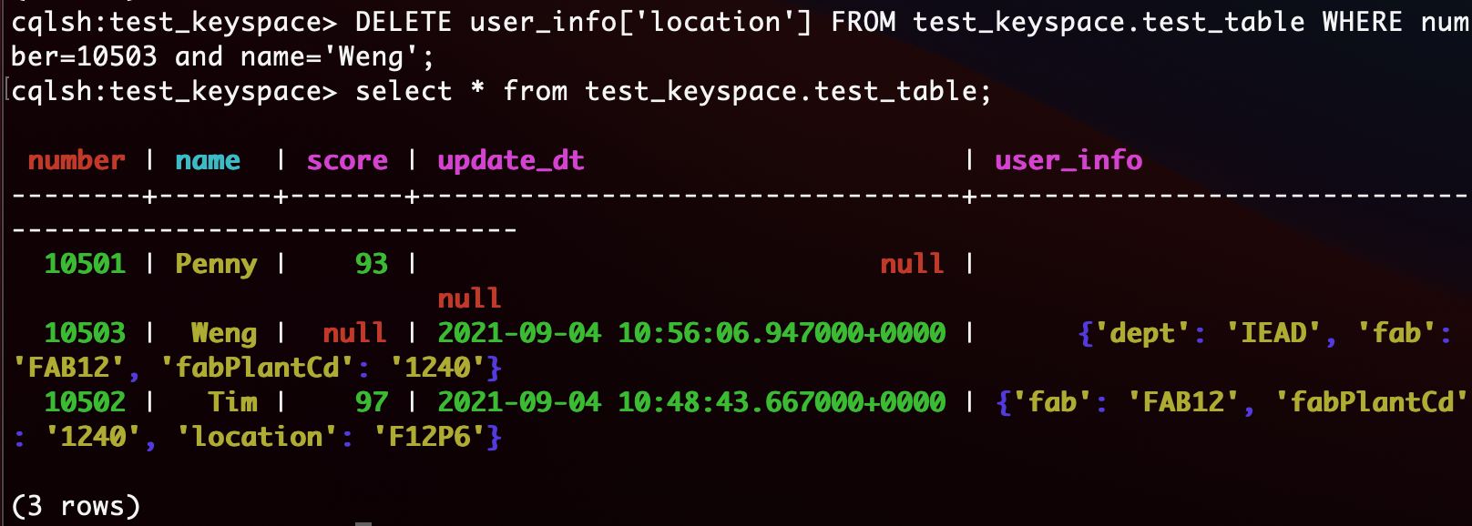
Data Types: Maps, Sets, Lists
Maps: Another delete key-value pairs’ way

Slide 28
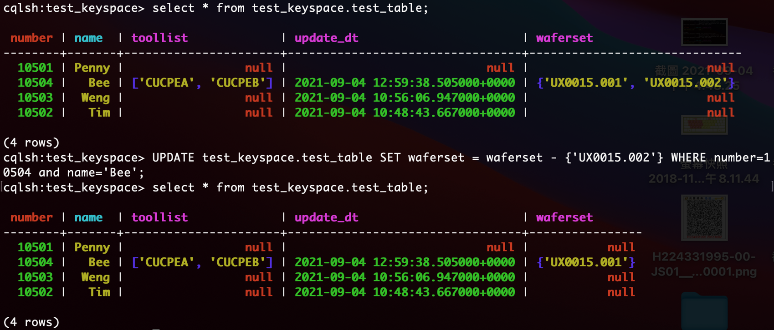
Data Types: Maps, Sets, Lists
Sets: Add or delete key-value pairs by “+” or “-”.
Notes:
UPDATE test_keyspace.test_table SET waferset = waferset - {'UX0015.002'} WHERE number=10504 and name='Bee';
select * from test_keyspace.test_table;

Slide 29
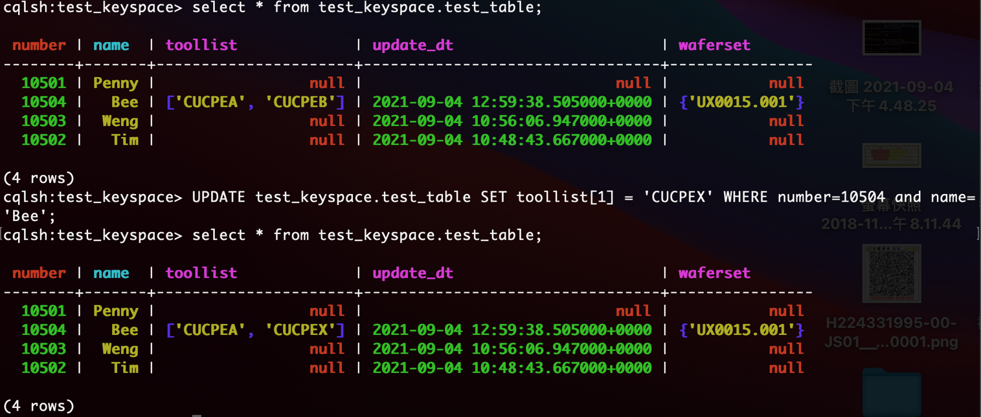
Data Types: Maps, Sets, Lists
Lists: 比起全部一起 update, 用 position 的方式 update performance 會比較不好.
Setting and removing an element by position and removing occurences of particular values incur an internal read-before-write. These operations will run slowly and use more resources than usual updates (with the exclusion of conditional write that have their own cost).

Slide 30
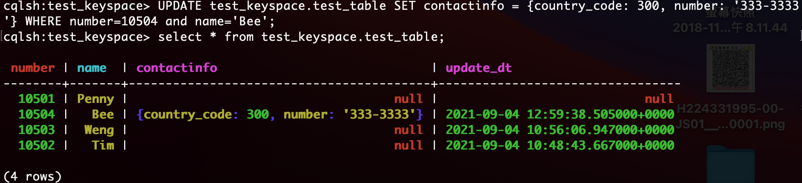
UDT (User-Defined Types)
CREATE TYPE phone (country_code int, number text);
ALTER TABLE test_keyspace.test_table ADD contactinfo phone;
UPDATE test_keyspace.test_table SET contactinfo = {country_code: 300, number: '333-3333'} WHERE number=10504 and name='Bee’;
Do not add quote “”, add quote will be read by Map type
Notes:
CREATE TYPE phone (country_code int, number text);
ALTER TABLE test_keyspace.test_table ADD contactinfo phone;
select * from test_keyspace.test_table;
UPDATE test_keyspace.test_table SET contactinfo = {country_code: 300, number: '333-3333'} WHERE number=10504 and name='Bee’;
select * from test_keyspace.test_table;

Slide 31
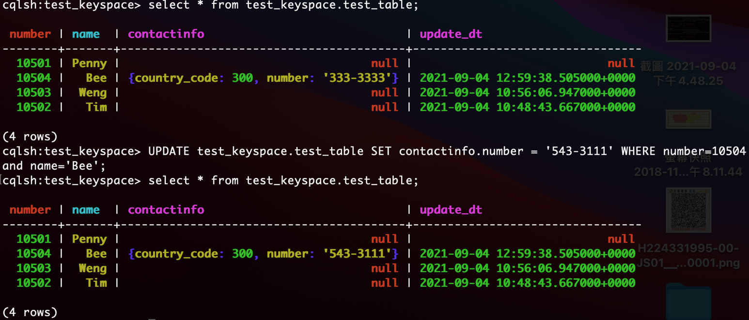
UDT (User-Defined Types)
UPDATE test_keyspace.test_table SET contactinfo = {country_code: 300, number: '333-3333'} WHERE number=10504 and name='Bee';

Slide 32
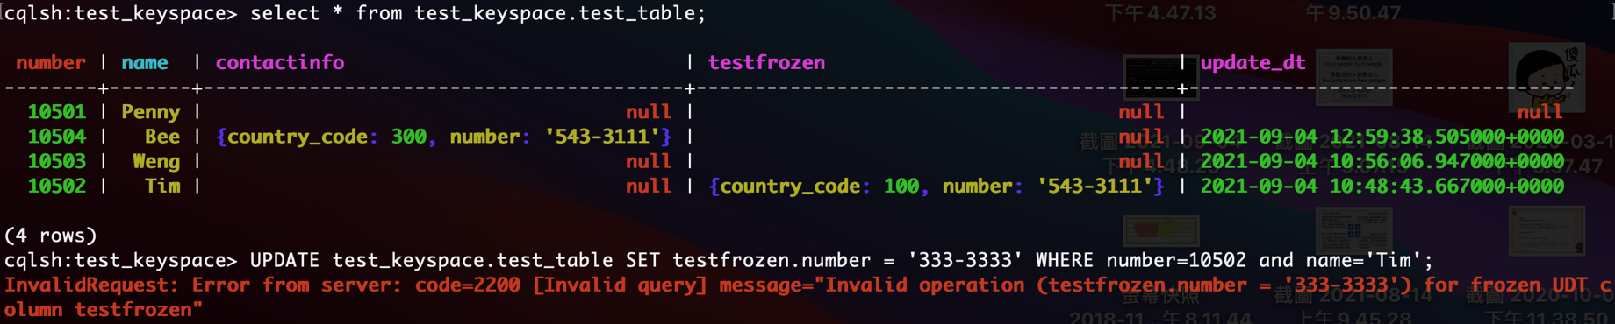
UDT (User-Defined Types)
Frozen 說明: A frozen value serializes multiple components into a single value. Non-frozen types allow updates to individual fields. Apache Cassandra™ treats the value of a frozen type as a blob. The entire value must be overwritten.
ALTER TABLE test_keyspace.test_table ADD testfrozen frozen<phone>;
UPDATE test_keyspace.test_table SET testfrozen = {country_code: 100, number: '543-3111'} WHERE number=10502 and name='Tim';
Frozen Error => UPDATE test_keyspace.test_table SET testfrozen.number = '333-3333' WHERE number=10502 and name='Tim';
Notes:
ALTER TABLE test_keyspace.test_table ADD testfrozen frozen<phone>;
select * from test_keyspace.test_table;
UPDATE test_keyspace.test_table SET testfrozen = {country_code: 100, number: '543-3111'} WHERE number=10502 and name='Tim';
select * from test_keyspace.test_table;
// Frozen Error
UPDATE test_keyspace.test_table SET testfrozen.number = '333-3333' WHERE number=10502 and name='Tim';

Slide 33
Reference
Cassandra document: https://cassandra.apache.org/doc/latest/cassandra/cql/index.html
Counter: https://www.cnblogs.com/didda/p/4789013.html
Duration: https://docs.datastax.com/en/dse/5.1/cql/cql/cql_reference/upsertDates.html
UDT: https://stackoverflow.com/questions/42532743/cassandra-frozen-keyword-meaning
SimpleStrategy vs NetworkTopologyStrategy: http://cooperbear2.blogspot.com/2018/08/cassandra-6-consistency-levels-and.html

Slide 34
BackUp

Slide 35
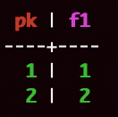
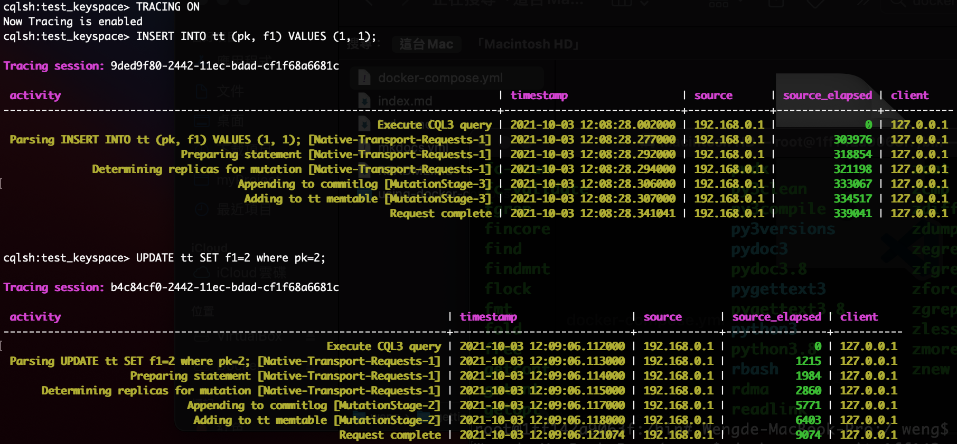
Insert / Update Row Disappear for Null Case

Slide 36
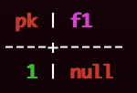
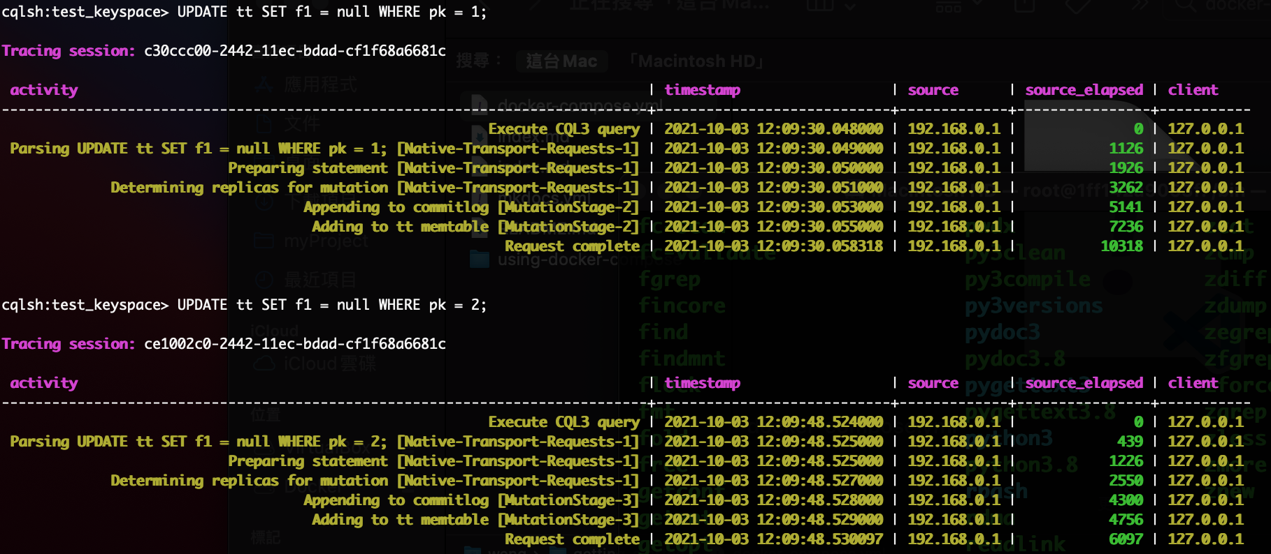
Insert / Update Row Disappear for Null Case

Slide 37
Insert / Update Row Disappear for Null Case
INSERT adds a row marker, while UPDATE does not.
The row marker makes a difference for rows in which all other cells are dead: a row shows up in a query if and only if there's at least one alive cell.
an UPDATE requests that individual cells of the row be added, but not that the row itself be added. However, an "INSERT" not only adds the cells, it also requests that the row be added (this is implemented via a "row marker"). So if later all the row's individual cells are deleted, an empty row remains behind.
Notes:
https://stackoverflow.com/questions/53596513/why-does-a-upserted-row-disappear-after-updating-the-column-to-null-but-not
https://issues.apache.org/jira/browse/CASSANDRA-14478
https://issues.apache.org/jira/browse/CASSANDRA-11805
https://stackoverflow.com/questions/17348558/does-an-update-become-an-implied-insert
Scylla does the same thing.
In Scylla and Cassandra rows are sequences of cells. Each column gets a corresponding cell (or a set of cells in the case of non-frozen collections or UDTs). But there is one additional, invisible cell - the row marker (in Scylla at least; I suspect Cassandra has something similar).
The row marker makes a difference for rows in which all other cells are dead: a row shows up in a query if and only if there's at least one alive cell. Thus, if the row marker is alive, the row will show up, even if all other columns were previously set to null using e.g. updates.
inserts create a live row marker, while updates don't touch the row marker, so clearly they are different. The example above illustrates that. One could argue that row markers are "internal" to Cassandra/Scylla, but as you can see, their effects are visible. Row markers affect your life whether you like it or not, so it may be useful to remember about them.
It's sad that no documentation mentions row markers (well, I found this: https://docs.scylladb.com/architecture/sstable/sstable2/sstable-data-file/#cql-row-marker but it's in the context of explaining SSTable internals, which is probably dedicated to Scylla developers more than to users).

